Slide 1
Exp 4 Design Of Free Lens for Single LED
《Optical design experiment》
Teacher: Xu linlin

Slide 2
均匀光场单自由曲面透镜发展及应用背景介绍
LED作为新一代的照明光源，具有光效高、功耗低、寿命长和绿色环保的优点，这正在改变人们的照明理念以及整个照明产业;
基于LED的半导体照明产业是国家战略性新兴产业，被列入《中华人民共和国国民经济和社会发展第十四个五年规划和2035年远景目标纲要》;
在LED照明应用中，各种照明标准中都有关于照度均匀度的要求。
照度均匀度高会给人们提供一个舒适、柔和的照明空间；反之，不均匀的照明会造成视觉疲劳，同时将可能引起不安定感。
最常见的白光LED封装器件的光强空间分布是朗伯型（Lambertian）配光，不适合进行直接照明应用。
自由曲面光学是一个新兴的LED照明光学技术，其优势在于具有较高的设计自由度和准确的光型控制，因此，自由曲面透镜设计在LED照明应用中得到了广泛的研究和应用。
目前，在LED照明灯具中，圆形光斑的LED照明灯具应用最为广泛，如LED MR16射灯、LED筒灯、LED舞台灯、LED球泡灯等；同时，在直下式LED背光、室内照明、商业照明等应用中通常也是通过多个圆形光斑叠加而成。

Slide 3

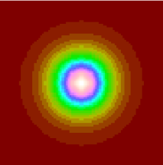
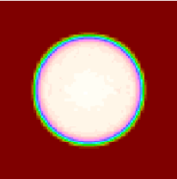
Aims of the free lens design
Light spot of Lambert light source.(I=I₀cos(θ))
Even round light spot.

Slide 4
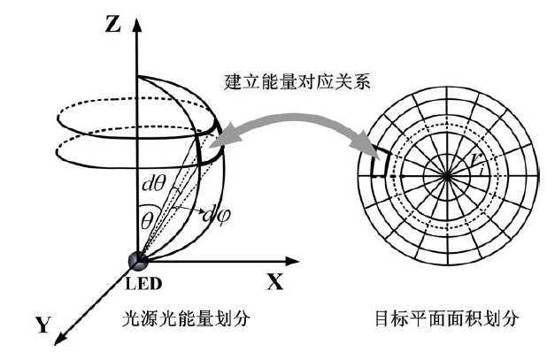
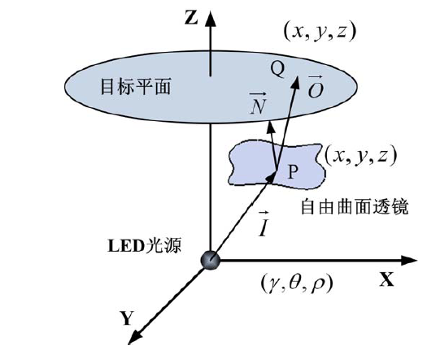
Design principle of free lens
Step 1:
Find out θ_{i}和r_{i} !
Theoretical basis :
Marginal ray theory: The light emitted from the edge of the light source will reach the edge of the target plane after passing through the optical system, and any light between the edges will hit the target plane.
θ_{i}
r_{i}
Free lens
Energy division of light source
Area division of the target plane
Diagram of energy correspondence between LED light source and target plane
r_{i}：Area equal subunit boundary radii
θ_{i}：Optical flux equal subunit boundary angles

Slide 5
Design principle of free lens
Step 2:
Find out lens surface curve coordinates P_{i} !
Theoretical basis:
Vector Snell refraction theorem：
[1+ n² − 2n(O⋅ I )]^{1/2}N = O – nI
x
Target plane
r₀
r₁
r₂
r₃
…
N₁
where：
I: unite vector of the input rays；
O: unite vector of the refracted rays;
N: normal unit vector at the refraction point;
n: the ratio between the refractive index of the input optical medium and that of the output optical medium.
N₂
P₀
P₁
P₂
N₃
P₃
…
θ₂
θ₃
θ₁
Lens surface curve
…
θ_{i}
o
Y
LED
Schematic diagram of the lens surface curve

Slide 6
x
目标平面
r₀
r₁
r₂
r₃
…
N₁
N₂
P₀
P₁
P₂
N₃
P₃
…
θ₂
θ₃
θ₁
…
自由透镜表面曲线
θ_{i}
o
Y
LED
自由透镜表面曲线构造示意图

Slide 7
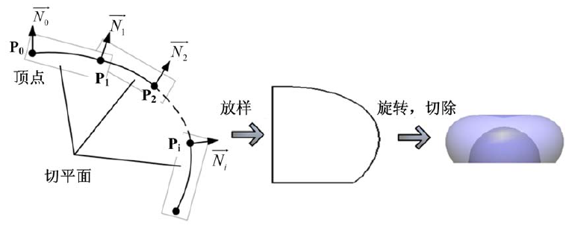
Design principle of free lens
Step 3:
Construct lens!
Vertex
Lens curve
Lens
Tangent plane of the lens.
By MATLAB
By Solidwork
Schematic diagram of the construction of the free surface lens.

Slide 8
Design principle of free lens
Simulation by TracePro and Zemax!
Step 4:
Method : Using the TracePro and Zemax to evaluate the lens by calculating the uniformity of the illuminance on the target plane, and the uniformity of the illuminance U_{E} should be larger than 0.9.

Slide 9
Notice:
Lens material: PMMA (refractive index: 1.49);
Height of the lens: 7 mm;
Position of the target plane: 1m from the LED;
Shape of the light spot on the target plane: round;
Light distribution curve I(θ) of the LED: I(θ)=I₀cos(θ), for convenience, I₀=1
Size of the LED:1mm*1mm*0.1mm;
Luminous angle range: 120°；
Since the height of the lens is much larger than the size of the LED, the LED source can be considered as a point source.

Slide 10
Requirments:
1. The report should include the description of the experimental process, the MATLAB code, picture of the lens, both TracePro and Zemax simulation results (with and without lens).
2. Simulation results for radii of bottom semisphere of 1.5,2,3,4mm and 5mm should all be given,including the corresponding illuminance uniformities.
3. The report should be submitted through Blackboard.

